Slide 1
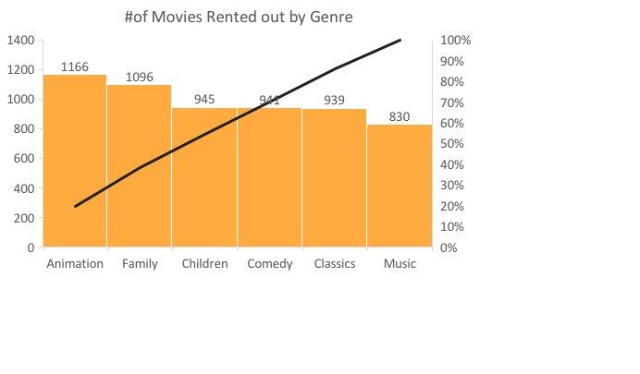
Q1: How many times were ‘Animation Movies’ rented out?
<Animation movies were rented out the most followed by family genre. Music genre was the least rented out category among family movies. >

Slide 2
<What is the shortest and longest rental duration?>
<Shortest rental duration is three days while the longest is seven days. Also seen from the graph, same rental days can be categorized into either 1st or 2nd quartile. >

Slide 3
Q3: Which genre of movie were most checked out in the 4th quartile of rental duration?
<In the 4th quartile of longest rented out movies, ‘Animation’ and ‘Family’ movies were the most popular genre.

Slide 4
<How many rentals did each store process in July and August of 2005? >
<Both stores performed similar in terms of rentals in both July and August of 2005>
*I couldn’t produce the whole data because the Project page was down (It contained ‘papers’ ERD not ‘actors’)
→ This data is from what I jotted down earlier while I was doing the project

